Slide 1

INTERNSHIP REPORT FOR MONTH 1
MITRE ENGAGE
GOALS AND IMPLEMENTATION
-ARUN ASHOK BADRI

Slide 2
INTERNSHIP GOALS :
(1) read the MITRE Engage documents; each one of you needs to select one of the goals (Expose, Affect, and Elicit) to study deeper and define each action under these goals in detail.
(2) Propose possible actions to be implemented in SSH honeypot and AD honeypot. There are about 10 to 20 actions listed under each goal. Try to propose corresponding actions for these two honeypots.
(3) Real implementation: Each of you needs to implement at least four actions according to your design in (2) in the real honeypots.

Slide 3
MITRE ENGAGE AND IMPLEMENTATION OF ANY ONE GOAL USING HONEYPOTS
INTERNSHIP REPORT PLAN
Month 1: Orientation and Goal Selection
Month 2: Proposal and Planning
Month 3: Implementation and Documentation

Slide 4
MITRE ENGAGE AND IMPLEMENTATION OF ANY ONE GOAL USING HONEYPOTS
INTERNSHIP REPORT PLAN
Week 1 & 2: Teambuilding and Introduction to MITRE
Week 3: Goal Selection and In-Depth Understanding
Week 4: Goal Selection and Introduction to Honeypots

Slide 5
Day 0
Arrival in Taiwan:
Date - 31 August 2023
Arrival in Tainan:
Time - 11:30 PM Via HSR

Slide 6
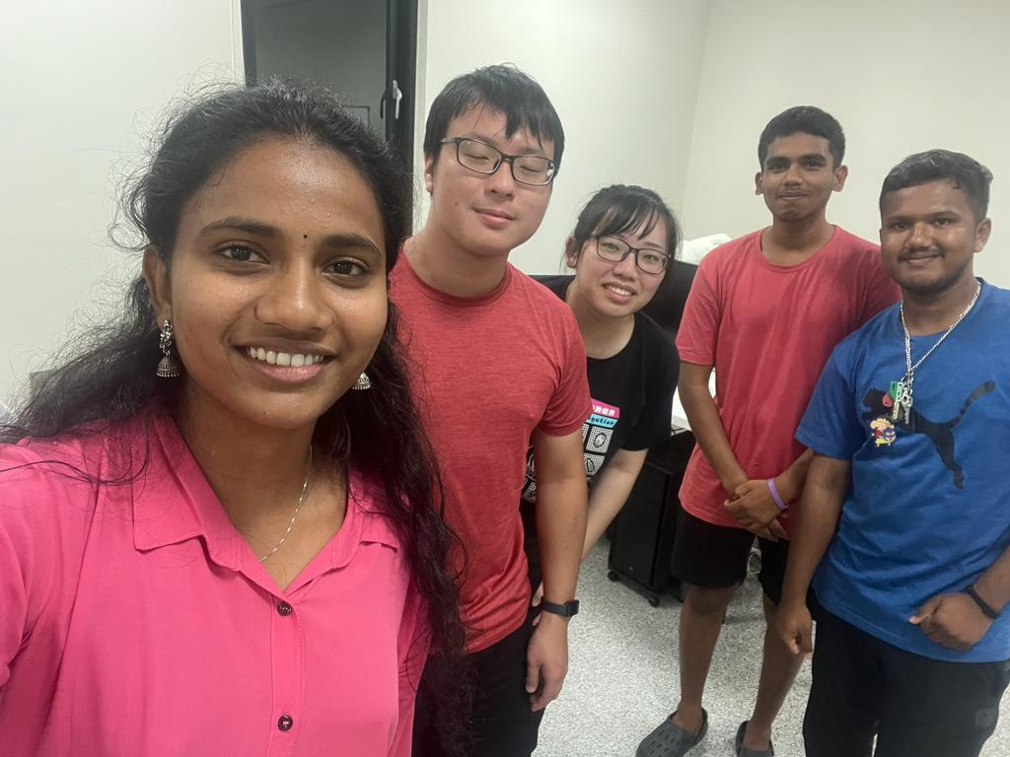
Day 0
> Meeting with Lab Seniors

Slide 7

Day 0
> Meeting with Dorm Friends
> Dinner with Dorm Friends

Slide 8
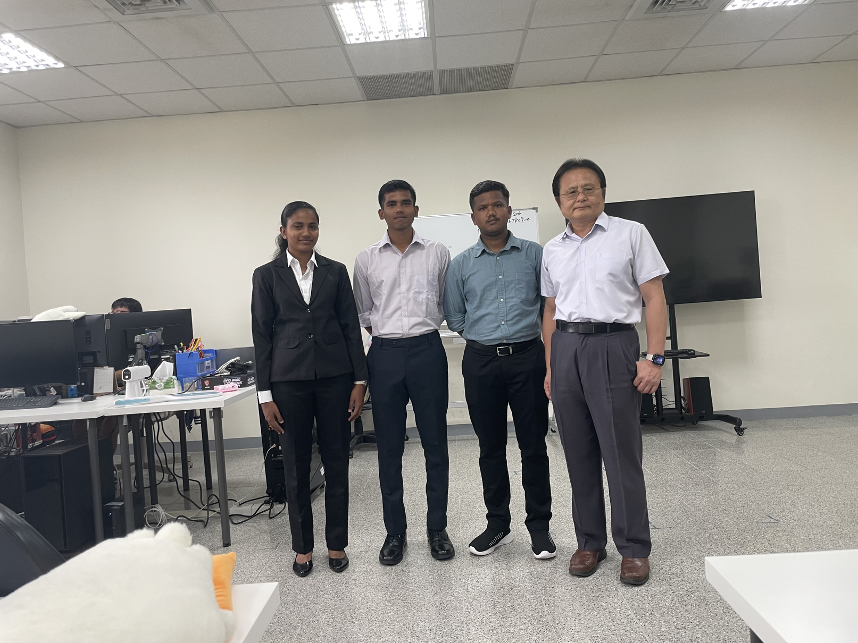
Day 1
> Meeting with Prof. Hwang
> Lunch
> Meeting with NIA Officials
> Meeting with Bank officials

Slide 9
Week 1 & 2
Below is our Internship Goal for Week 1 & 2
(1) Team building and Introduction
(2) Read and understand the MITRE Engage documents;

Slide 10
MITRE
WHAT IS IT ?
PROMINENT CYBERSECURITY FRAMEWORKS :
The MITRE Corporation is an American not-for-profit organization
MITRE is a government-funded research organization based in Bedford, MA, and McLean, VA.
The company was spun out of MIT in 1958 and has been involved in a range of commercial and top secret projects for a range of agencies.
MITRE has a substantial cybersecurity practice funded by the National Institute of Standards and Technology (NIST).
 | ATT&CK
 | ENGAGE
 | D3FEND
 | CALDERA

Slide 11
MITRE ENGAGE
MITRE Engage is a knowledge base developed by the MITRE corporation, initially known as MITRE Shield. It provides
ACTIVE DEFENSE information based on ten years of adversary engagement experience
To help work with the data, MITRE provides mappings that organize views. It includes a mapping between Engage and the MITRE ATT&CK® framework.
It was released in order to stimulate conversations about adversary engagement and ACTIVE DEFENSE, as well as ways in which defenders can employ active defense.

Slide 12
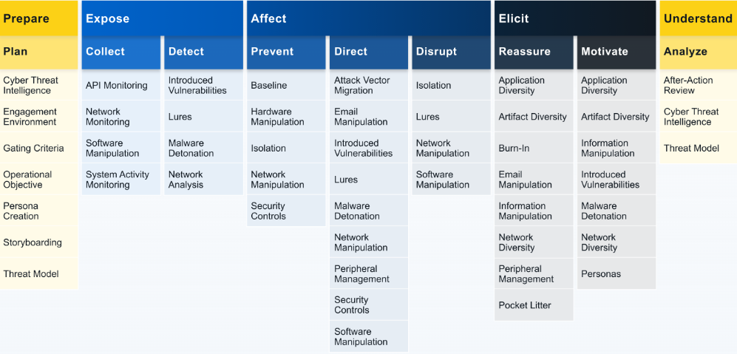
ENGAGE MATRIX

Slide 13
ENGAGE MATRIX
ENGAGEMENT OPERATIONS
1. EXPOSE (Collect & Detect) -- We can Expose adversaries on the network by using deceptive activities to provide high fidelity alerts when adversaries are active in the engagement environment.
2. AFFECT (Prevent, Direct & Disrupt) -- We can Affect adversaries by having a negative impact on their operations. Affect activities are ultimately about changing the cost-value proposition in cyber operations for the adversary.
3. ELICIT (Reassure & Motivate)-- We can Elicit information about the adversary to learn about their TTPs. By creating an engagement environment that is uniquely tailored to engage with specific adversaries, the defenders can encourage the adversary to reveal additional or more advanced capabilities.

Slide 14
Week 3
Below is our Internship Goal for Week 3
(1) Selecting one of the goals (Expose, Affect, and Elicit) to study deeper and defining each action under these goals in detail.

Slide 15
ENGAGE Goal: AFFECT
AFFECT ID: EGO0002 Negatively impact the adversaries operations.
Affect is ultimately about changing the cost-value proposition in cyber operations for the adversary.
For example, the defender can negatively impact the adversary’s on-network operations to drive up the resource cost of doing operations by slowing down or selectively resetting connections to impact exfiltration.
Goal: increase operational costs and decrease the value of collected data

Slide 16

ENGAGE MATRIX

Slide 17
1. PREVENT
PREVENT
ID: EAP0003
Stop all or part of the adversary’s ability to conduct their operation as intended.
The defender can physically or virtually remove or disable resources, tighten security controls, or otherwise impair the adversary’s ability to operate
Additionally, a defender can use prevention activities to discourage the adversary from operating against a specific target.
ENGAGE uses a combination of Denial, Deception, and Adversary Engagement technologies to Affect the Adversary

Slide 18
2. DIRECT
DIRECT ID: EAP0004
Encourage or discourage the adversary from conducting their operation as intended.
Direction activities focus on moving the adversary towards or away from an intended path. This forced direction can be accomplished by removing or disabling some resources, while adding or enabling others.
the defender can tighten some security controls while leaving others overly permissive or weakened
GOAL: the defender hopes to force the adversary to take unintended actions or stop intended actions.

Slide 19
3. DISRUPT
DISRUPT ID: EAP0005
Impair an adversary’s ability to conduct their operation as intended.
Disruption activities are used to stop or discourage an adversary from conducting part or all of their mission
This disruption may increase the time, skills, or resources needed for the adversary to accomplish a specific task
Eg: a defender may degrade network speeds as the adversary attempts to exfiltrate large blocks of data.

Slide 20
ELASTICSEARCH/ Kibana
Elasticsearch is a powerful, open-source search and analytics engine that is used for a wide range of data analysis and search applications.
It is a part of the Elastic Stack, which includes tools like Logstash and Kibana.

Slide 21
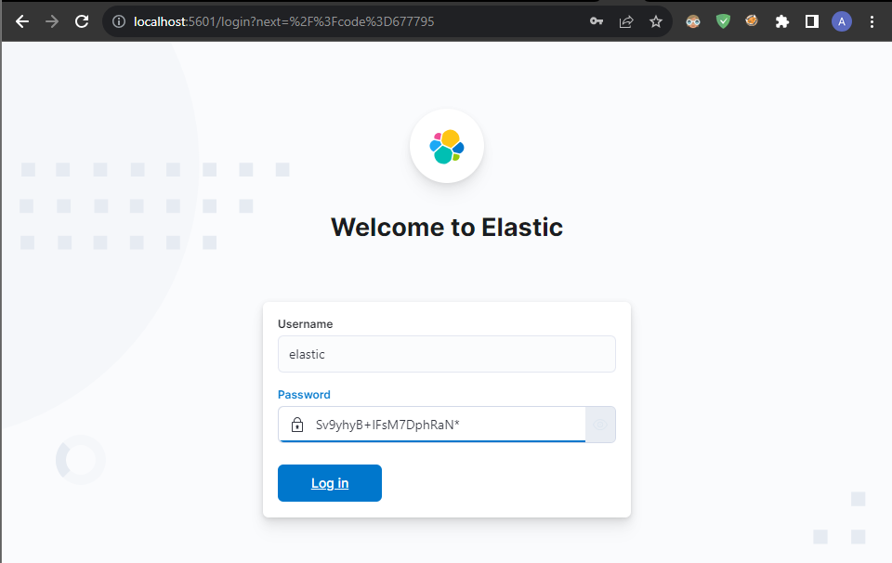
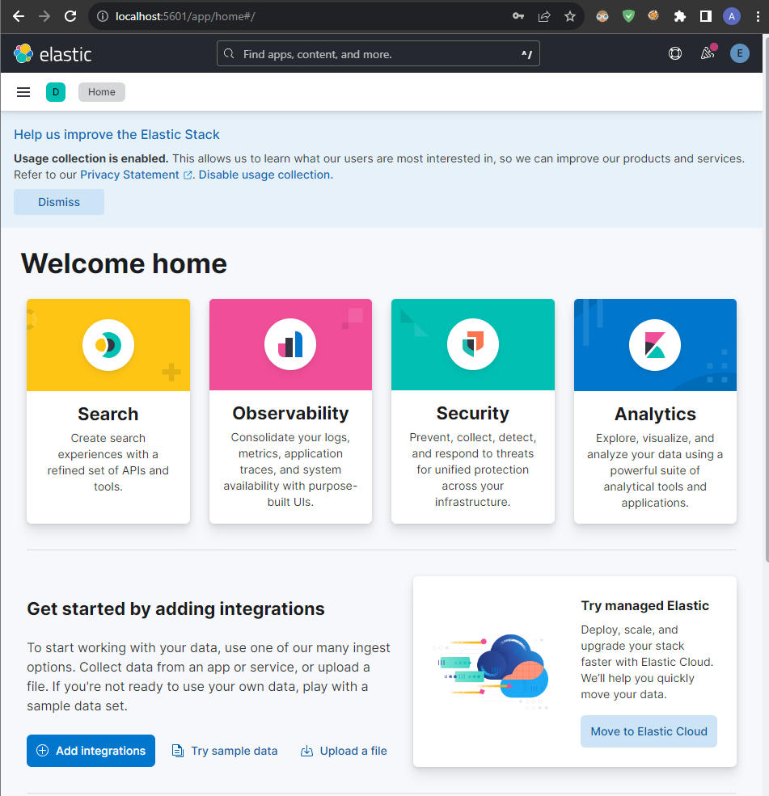


Slide 22
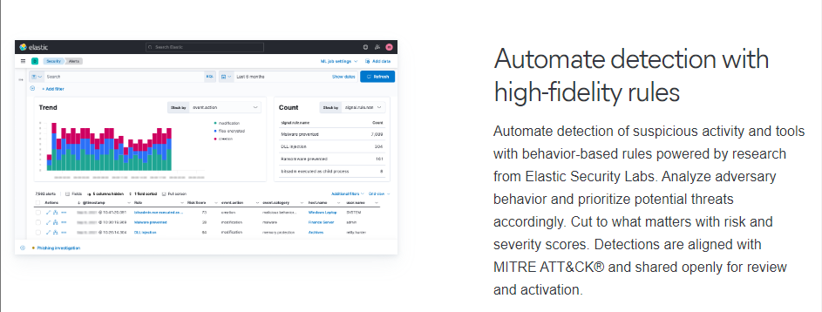
ElasticSearch + SIEM Analytical Capabilities

Slide 23
Real world demonstration of
Elasticsearch & Kibana
Explanation of the Scenario:
Attacker (workstation) tries to DDOS a small server (Virtual machine)
Attacker IP: 140.113.110.115
Virtual Machine IP: 192.168.98.129
DDOS by PING command (Windows Powershell)
Command used to ping --> 1..1000000 | ForEach-Object { Test-Connection -Count 1 -ComputerName 192.168.98.129 }
The above command will send 1 Million PIng Packets to the Server

Slide 24
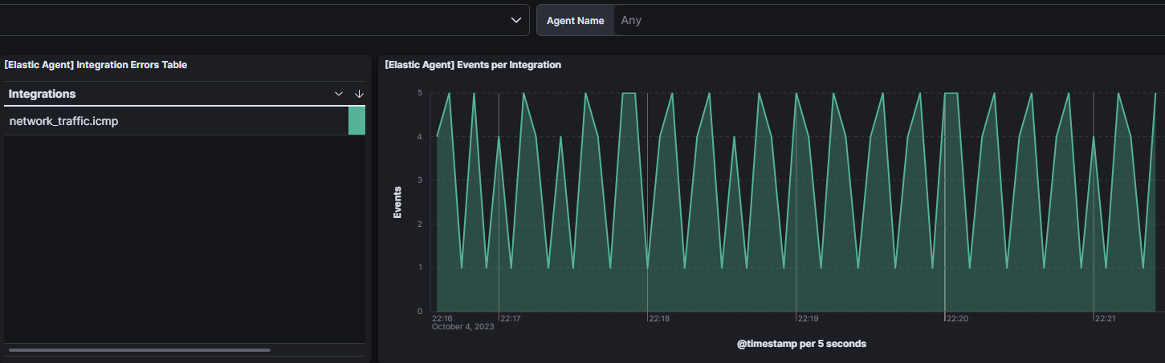
Before Sending Pings
5 Packets

Slide 25
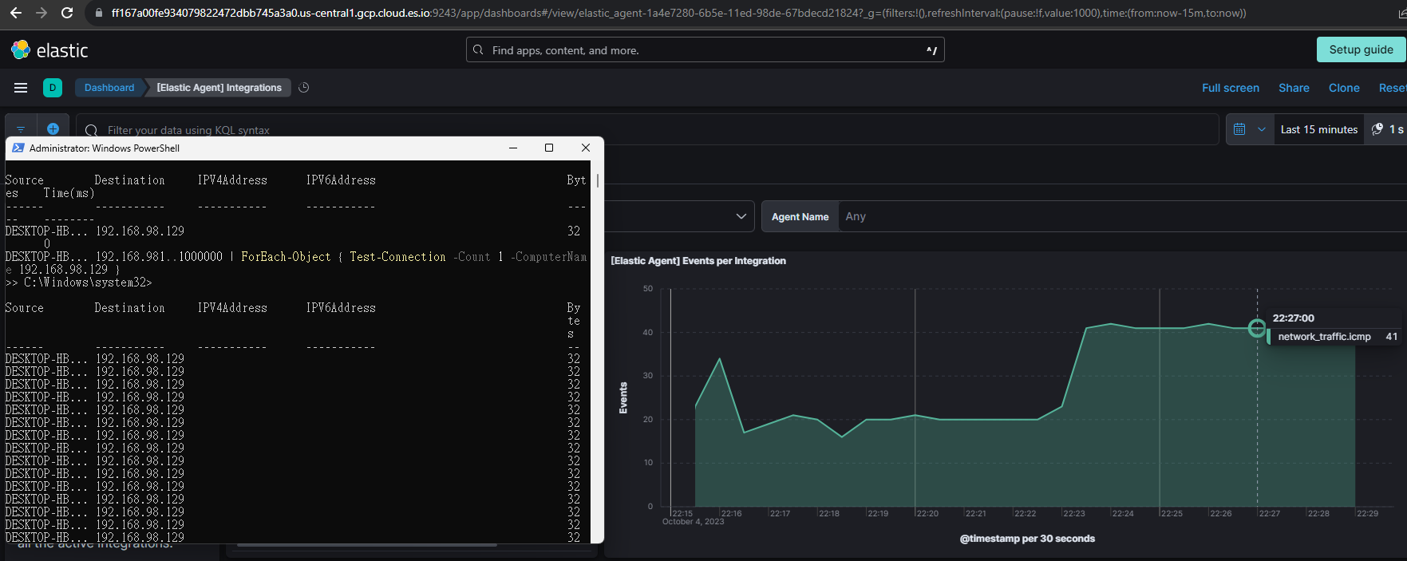
After Sending Pings
Ping packets being sent via Powershell
41 Packets

Slide 26
Week 4
Below is our Internship Goal for Week 4
(1) Study deeper and understand the AFFECT goal and try to implement it physically
(2) Study Honeypots and Implement it physically on a system

Slide 27
Honeypot
Honeypots refer to decoy servers or systems that are deployed next to systems your organization actually uses for production.
Honeypots are designed to look like attractive targets, and they get deployed to allow IT teams to monitor the system’s security responses and to redirect the attacker away from their intended target.
Honeypots use security vulnerabilities to lure in attackers. They may have ports that are vulnerable to a port scan, which is a technique for figuring out which ports are open on a network. A port left open may entice an attacker, allowing the security team to observe how they approach their attack.

Slide 28
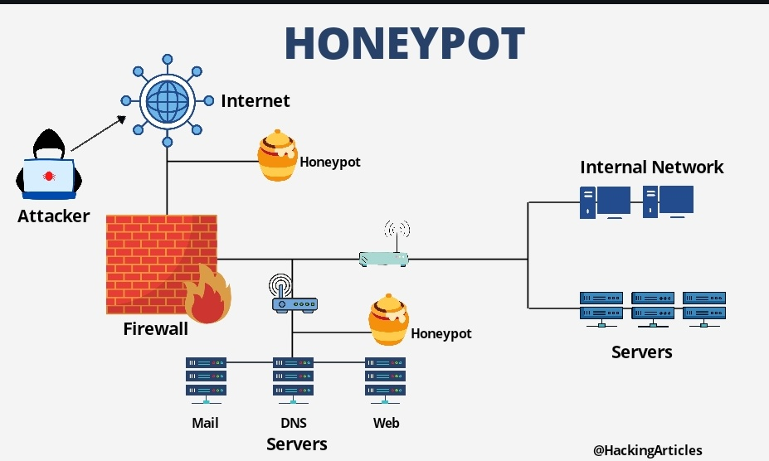

Slide 29
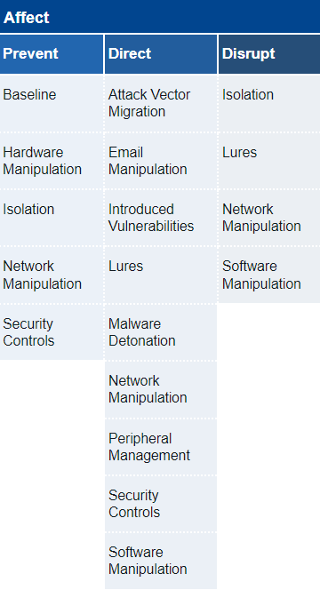


HONEYPOTS CAN BE USED TO ACHIEVE -
. ISOLATION : Honeypots can ensure that certain networks are isolated
. LURES : Using Honeypots we can introduce Lures and Decoys against the Adversaries
. NETWORK MANIPULATION : We can manipulate the network by installing Honeypots and trick the adversaries

Slide 30
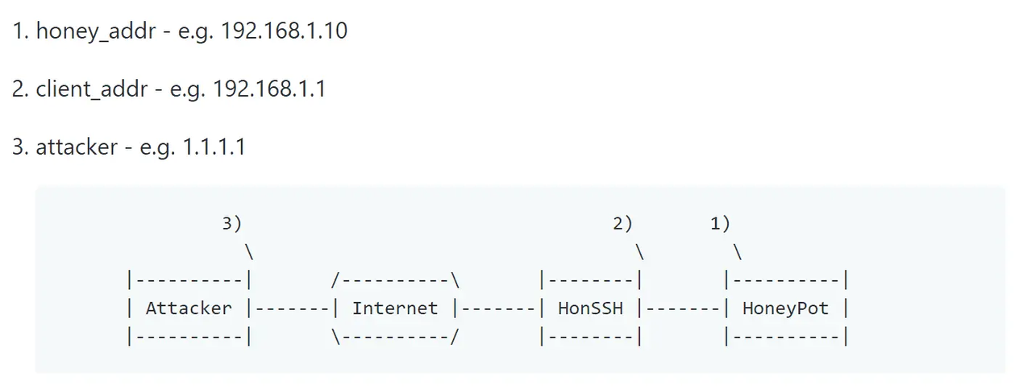
HonSSH
HonSSH is designed to be used in conjunction with a high interaction honeypot. HonSSH sits between the attacker and the honey pot and creates two separate SSH conncetions.
It will sit between an attacker and a honeypot, creating two separate SSH connections between them.

Slide 31
NETWORK MANIPULATION / DECEPTION
Trying to create a network environment in which we can implement an honeypot and try to determine the AFFECT it has on the adversarial attacks.
Tools needed are:
Proxmox VE
HonSSH
Kali Linux
And their individual requirements

Slide 32
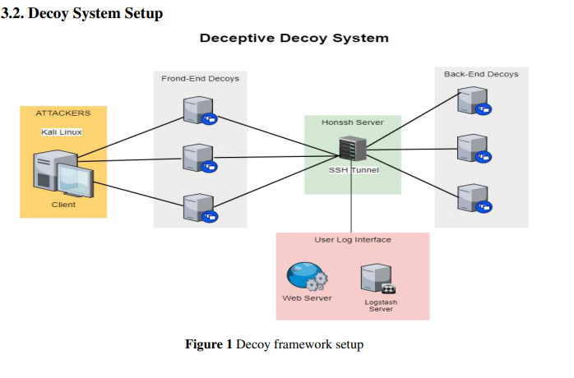
NETWORK MANIPULATION/ DECEPTION
VM2
VM1
VM3
PROXMOX VIRTUAL ENVIRONMENT

Slide 33
Network manipulation Setup
VM1 -- ATTACKER
VM2 -- GATEWAY
VM3 -- ANALYSIS & LOGGING
OS: Kali Linux
Same network
Attacks using Nmap and other tools
Eg: Os fingerprinting,
Directory Search
OS: Ubuntu Server
Same network
Uses HonSSH to tunnel between decoy and the honeypot
OS: Ubuntu Server 18.0
Same network
Elasticsearch, Kibana, Logstash
The integration of these 3 tools is used for log analysis

Slide 34
Network manipulation Setup (Additional)
VM2 -- GATEWAY
OS: Ubuntu Server
Same network
Uses HonSSH to tunnel between decoy and the honeypot
CT1 -- FRONTEND DECOY
CT2 -- BACKEND DECOY
OS: Ubuntu LCX
MySQL, Apache Etc
Same network
Serves as a decoy back end and also tunnels data via SSH
OS: Ubuntu LCX
Same network
Serves as a fake frontend and it is tunneled via SSH

Slide 35
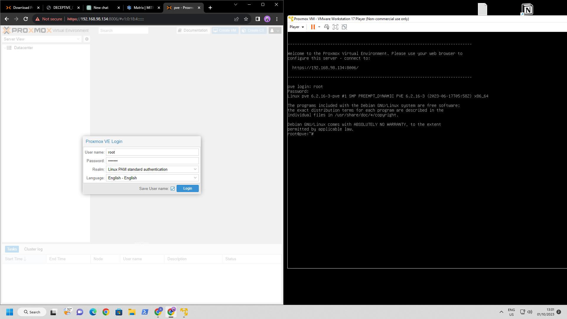


Slide 36
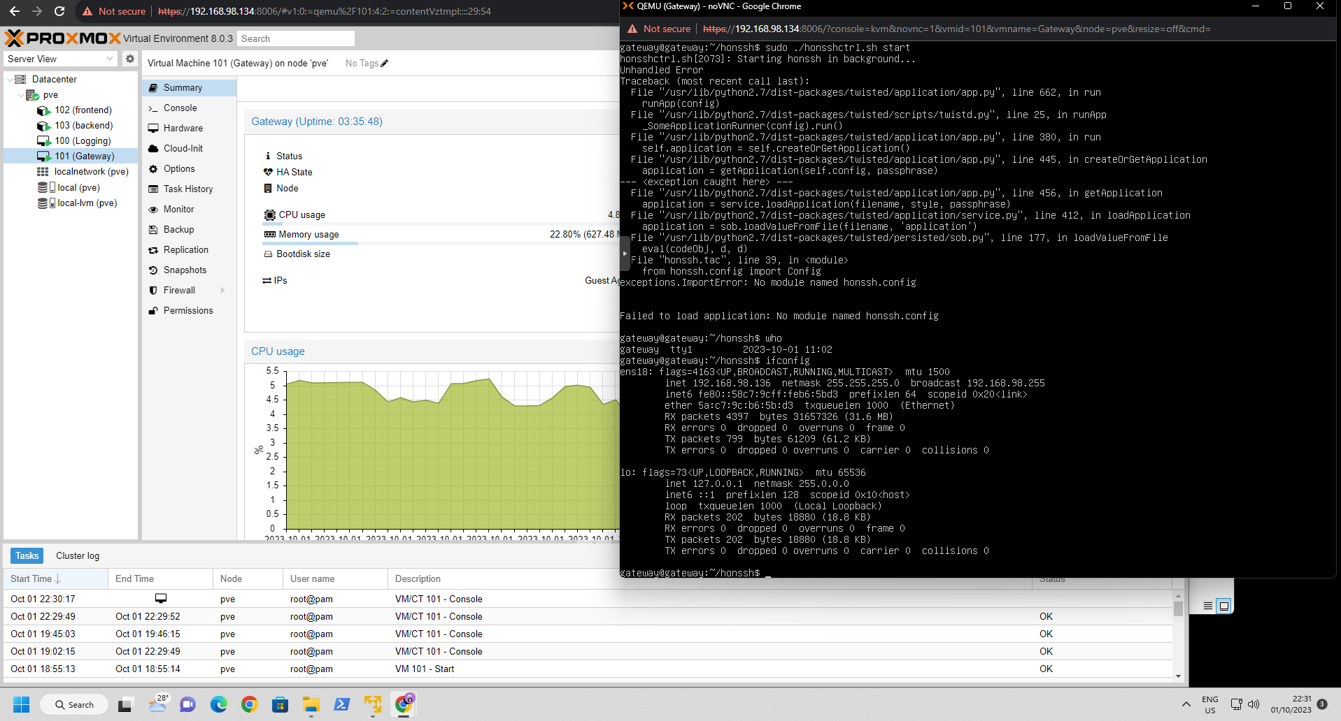

Slide 37

HonSSH installation
Git Clone into the following Repo
https://github.com/tnich/honssh
cd into the Directory
Edit the “honssh.cfg.default” file in the direcory with suitable values

Slide 38
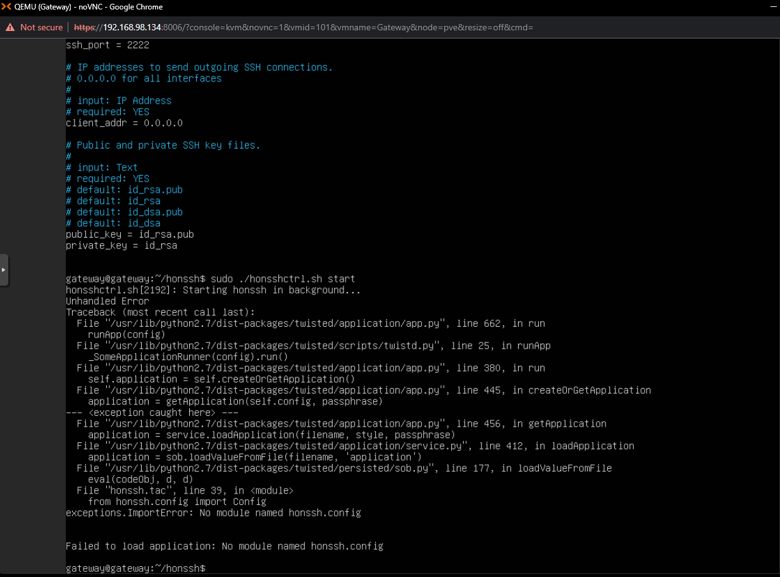


Once everything is ready we can run the HonSSH using this command
Error during the installation
-- Needs to be Rectified

Slide 39
Next Steps in the Implementation
-> Rectify the Error in HonSSH
-> Setup ELK (Elasticsearch, Logstash, Kibana) in the VM3
-> Setup SSH tunneling in the Frontend and Backend Decoys
-> Configure VM1 Kali Linux
-> Setup fake virtual IP’s in the Network via HonSSH
-> Setup Password logging feature of the HonSSH
-> Integrate and test the final Environment using real world attack

Slide 40
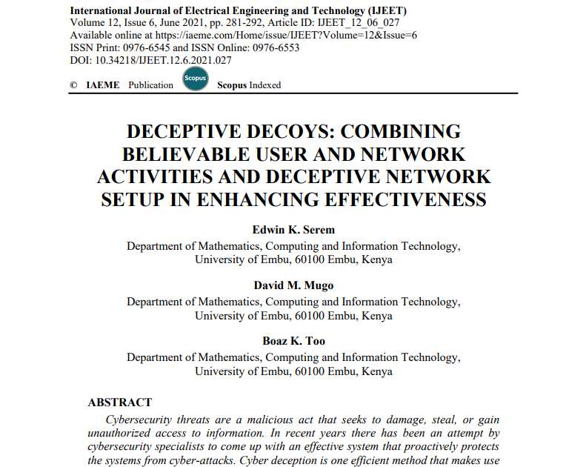
Reference material
https://iaeme.com/MasterAdmin/Journal_uploads/IJEET/VOLUME_12_ISSUE_6/IJEET_12_06_027.pdf
Research paper on “combination of deceptive network and Honeypots to increase effective security”

Slide 41

Internship Progress so far -
(1) read the MITRE Engage documents; each one of you needs to select one of the goals (Expose, Affect, and Elicit) to study deeper and define each action under these goals in detail.
(2) Propose possible actions to be implemented in SSH honeypot and AD honeypot. There are about 10 to 20 actions listed under each goal. Try to propose corresponding actions for these two honeypots.
(3) Real implementation: Each of you needs to implement at least four actions according to your design in (2) in the real honeypots.

Slide 42
Experience So far -
> Really nice people
> Different Food habits // for a vegetarian
> Great Research environment
> Helpful People everywhere
> Very good atmosphere

Slide 43
Thank
you!
谢谢

